Slide 1


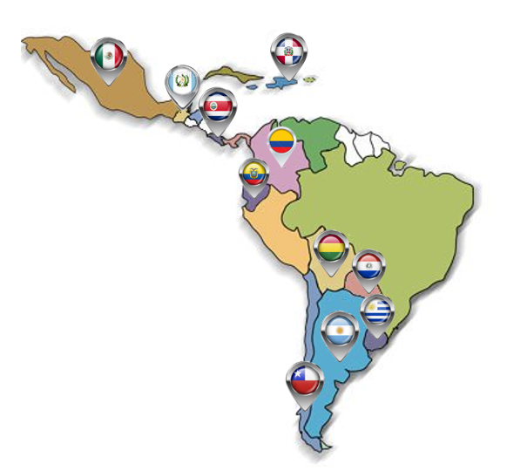
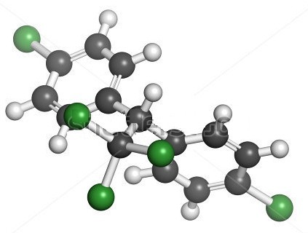
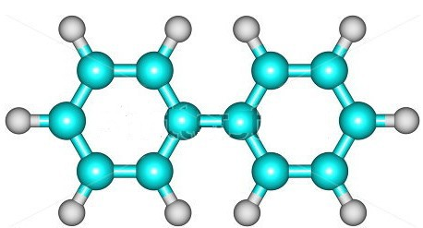
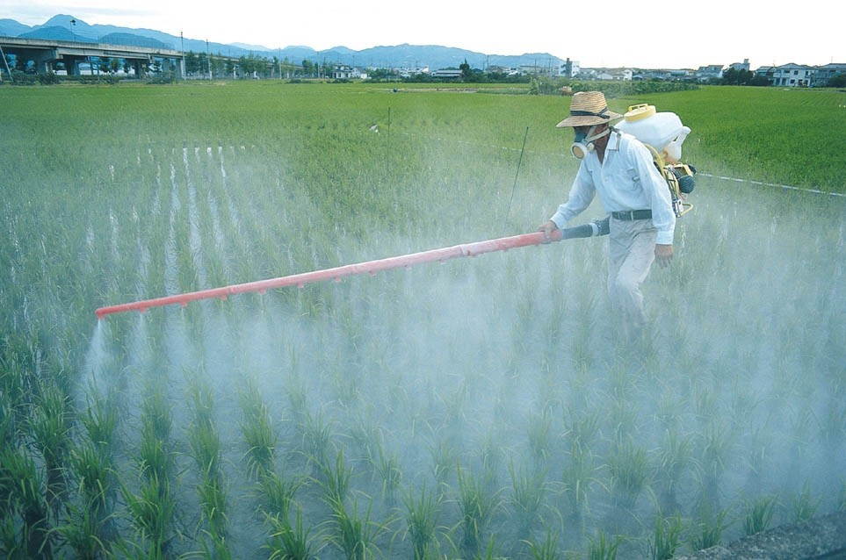
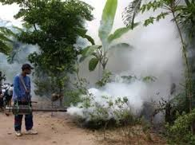



P. Gatti¹ ; C. Carrasco²; P.F. Enríquez Alfaro³; J.Guerrero Dallos⁴; M.A. Masis Mora⁵; C.R. Castro Palacios ⁶; G. García Rosales ⁷; S.Caballero de Colombo⁸; E.G. Egaña Cerni⁹; M.G. Álvarez de la Cruz de Morales¹⁰; A.Ramírez Sánchez¹¹
Instituto Nacional de Tecnología Industrial (INTI ) ARGENTINA; ² Instituto de Investigación en Salud y Desarrollo (ECUADOR); ³ Servicio Agrícola y Ganadero (SAG, CHILE) ); ⁴Universidad Nacional de Colombia (COLOMBIA) ); ⁵Universidad de Costa Rica (UCR) ; ⁶ Ministerio de Electricidad y Energía Renovable (ECUADOR); ⁷ Instituto Tecnológico de Toluca (MÉXICO) ; ⁸ Universidad Nacional de Asunción (PARAGUAY) ; ⁹ Intendencia Municipal de Montevideo (URUGUAY) ; ¹⁰ Laboratorio Nacional de Salud (GUATEMALA); ¹¹ Instituto de Innovación en Biotecnología e Industria (REPUBLICA DOMINICANA).
The interest on the toxicity in humans and the contamination on the environment by Persistent Organic pollutants has been the subject of study of many researchers, associating them with industry, labour, environmental and dietary exposure. The organochlorine pesticides (POP´S) (Figure 1a) and the polychlorinated byphenyl (PCB) (Figure 1b) congeners are part of compounds currently known as Persistent Organic Pollutants (POPs) for their presence across the planet, their stability and slow biodegradation, their accumulation in fatty tissues and long half- life. Most of them are currently banned also in Latin American countries due to their confirmed toxicity for humans and also in biotic communities.
a) b)
All the countries participating in the project (Argentina, Bolivia, Chile, Colombia, Costa Rica, Ecuador, Guatemala, Mexico, Paraguay, R Dominicana and Uruguay) are among the countries that have ratified the Stockholm Convention, so the National Implementation Plans (NIPs) represent important support and a guarantee of commitment to the success of the project.
The following compounds will be analyzed of the laboratories of each participating countries.
cis-Chlordane PCB28 trans-Chlordane PCB52
Dieldrin PCB 101
Endosulfan PCB 118
Endrin PCB 138
Heptachlor PCB 153
Heptachlor epoxide (cis) PCB 180
Heptachlor epoxide (trans)
Hexachlorobencene (HCB)
Lindane
Mirex
Pentachlorobencene
o,p´-DDT
p,p´-DDT
The sample zones and matrices to be analyzed are shown below.
Figure 1 Molecules: a) DDT (dichlorodiphenyltrichloroethane) molecule. Controversial pesticide, used in agriculture and for malaria disease vector control. Atoms are represented as spheres with conventional color coding; b) Biphenyl (or diphenyl) is an organic compound that forms colorless crystals. It has a distinctively pleasant smell.
Sampling
Zone
Rural
Aaquaculture
Wild Fishing
Low Exposition
Non- Aquaculture
Non- Industrial
Forestal
Farming
Non- Agricultural
Urban
Industrial
Organochlorine pesticides are chlorinated hydrocarbons used extensively from the 1940s through the 1960s in agriculture and mosquito control.
Project Objective: The overall objective is to "Improve environmental quality and reduce human exposure to persistent organic pollutants (POPs) by establishing a correlation between amounts of POPs found in humans and the environment that they live in" thereby paving a pathway for reducing the human and environmental health impacts of the POPs. Within the overall objective, the following project specific objectives have been identified:
Study the degree and modes of exposure to POPs for different population groups in Latin America and establish a correlation between the presence of POPs in human milk, drinking water and food/animal feed samples and their presence in the local environment.
Link the level of human exposure to POPs with environmental, social, employment and, residential factors, to establish criteria that can be used by different stakeholders related to this subject.
Identify key risk groups and contaminated areas to aid in establishing policies to protect human beings from exposure to POPs and enable mitigating action for environmental clean-up.
Soil
Water
Foods
Sediment
Breast milk
They persist in the environment due to their long half-lives and continue to be transferred to humans via food and water intake among other pathways for human exposure.
PROJECT PROGRESS
Within the Regional courses carried out, the aspects covered were related to the general introduction of POPs, useful life, degradation properties, bioaccumulation and environmental properties, as well as the evaluation of the risk assessments carried out by the EPA during the registration process of a pesticide, including the risk assessment for humans and the toxicological evaluation of pesticides.
Important aspects were the risk communication, specifically how risk management and communication should be carried out in the non-scientific population and the need to determine specific population groups (teachers, doctors, priests) to assist in the correct communication of the results of the study.
Another important aspect acquired in the last regional courses is related to the population and how exposed to persistent organic pollutants and how these compounds interact with the organism. Important knowledge obtained, involves the identification of those parameters that must be taken into account at the moment of the risk analysis, as well as identifying bibliographic sites where databases containing toxicological information of POPs are found, and the introduction to the use of updated tools for hazard characterization and risk mapping.
2015
Baseline information of COPs contamination in each country and analytical capabilities
2019
Data evaluation
Development of risk maps
Presentation and communication of results
2017
Environmental sampling activities
Analytical measurement /validation and quality control
2016
Risk assessment evaluation
Sample definition (zones/samples/molecules)
POPs Pathways in environment and food
2018
Sampling and analytical measurements of samples in participating countries
In lactation, milk is a major route of elimination of these compounds, but is also an important route of exposure for infants.
In Latin America, there are large geographic areas where agricultural and industrial activity is conducted, while nearby there are residential and recreational areas. The populations are established in areas where these activities coexist.
Data from inventories of POPs shows that there are POPs deposits in most of the countries becoming a risk and contamination source. At the moment, there is insufficient regional assessments of the presence of or exposure to POPs in different human population groups or the environment.
The ARCAL-PER Regional Strategic Profile for Latin America and Caribbean (LAC) 2016-2021 includes this topic and needs have been identified in the Food Safety and Environment areas. In this context countries of LAC have come together to develop this project with the support of the IAEA.
The results will provide tools to decision makers in each country in order to integrate policies to reduce the risk of pollution in the population and the environment and, as far as possible, evaluate the relationship between the levels detected of POPs and their association with environmental, social, employment and residence factors.
REFERENCES
[1] Regional cooperation agreement for the promotion of nuclear science and technology in Latin America and the Caribbean. https://www.iaea.org/about/partnerships/regional/cooperative-agreements/regional-cooperation-agreement-for-the-promotion-of-nuclear-science-and-technology-in-latin-america-and-the-caribbean-arcal.
[2] Regional Strategic Profile (PER) 2016-2021. https://inis.iaea.org/search/search.aspx?orig_q=RN:46122983.
[3] RALACA. http://www.red-ralaca.net/.
[4] Stockholm Convention. http://chm.pops.int/default.aspx.
[5] UNDP Biennial Studies. http://web.undp.org/execbrd/pdf/dp2010-3.pdf.

